Slide 1
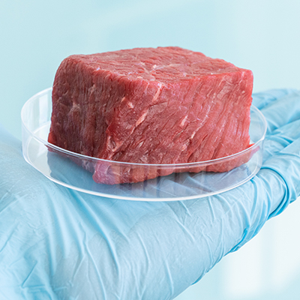
Choosing the ‘right’ meat that has been produced sustainably
Bob

Slide 2
What is the “right” meat
Meat analogue
More Sustainably Sourced Meat
(Tombs, 1974)
Plant-based
Lab- based
(Gobble,2012)

Slide 3
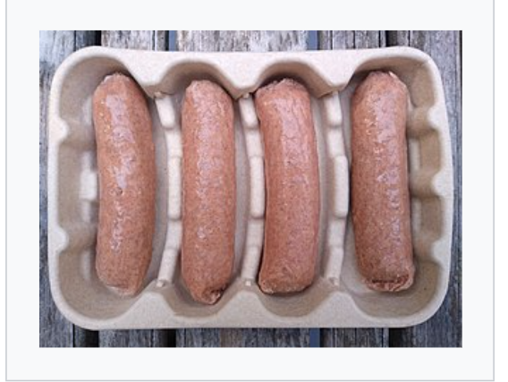
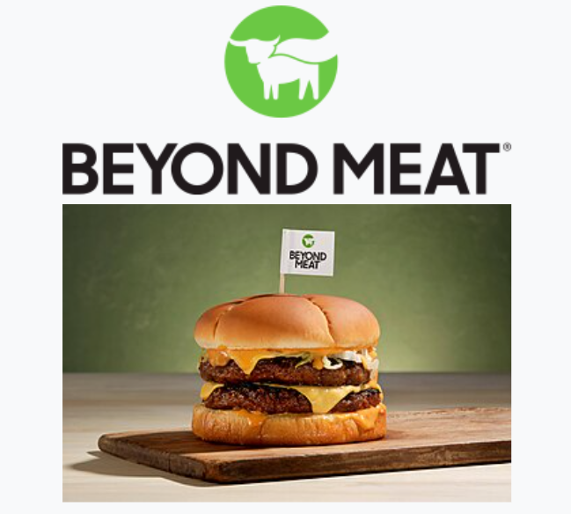
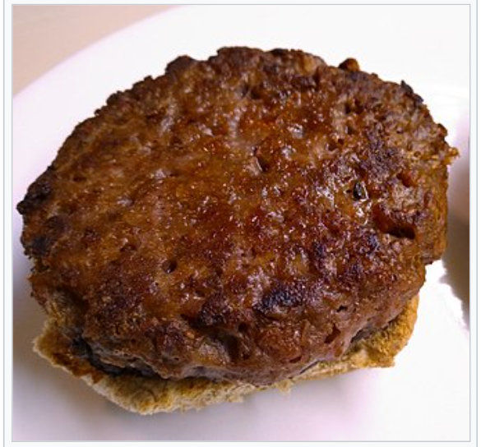
Beyond sausages
Beyond meat burger

Slide 4
Sustainability
Environment
economic
social
Less land,water high
efficiency
Less cost
Health
Ethic
(Rubio 2020)
(Rubio&Kaplan&Xiang 2020)
Kumar(2016)

Slide 5
, ,
Reference
Gobble. (2023)Sustainably Sourced Meat: Your Guide To Responsible Eating
https://www.gobble.com/blog/sustainably-sourced-meat/
Konstantina Kyriakopoulou, &Birgit Dekkers,& Atze Jan van der Goot(2019). Sustainable Meat Production and Processing
https://www.sciencedirect.com/science/article/pii/B9780128148747000067#s0070
Natalie R.,&Ning.,&David L.(2020).Plant-based and cell-based approaches to meat production
https://www.nature.com/articles/s41467-020-20061-y
Pavan Kumar&M. K. Chatli,&Nitin Mehta,&Parminder Singh,&O. P. Malav &Akhilesh K. Verma.Meat analogues(2019). Health promising sustainable meat substitutes
https://www.tandfonline.com/doi/full/10.1080/10408398.2014.939739

